Slide 1
Data and Computer Communications
Chapter 22 – Internet Applications
Electronic Mail and
Network Management
Eighth Edition
by William Stallings
Lecture slides by Lawrie Brown
Notes:
Lecture slides prepared by Dr Lawrie Brown (UNSW@ADFA) for “Data and Computer Communications”, 8/e, by William Stallings, Chapter 22 “Internet Applications - Electronic Mail and Network Management”.

Slide 2
Internet Applications
Electronic Mail and
Network Management
One of the most exciting aspects of birds' lives is how they interact with others during such social activities as defending territories, courting mates, nesting, raising young, and flocking. Birds' level of sociability changes with the seasons; they may be gregarious at certain times of year yet highly territorial at others. Some of the most fascinating behavior occurs in spring and summer when birds are engaged in breeding. During a social interaction, an individual is coordinating its activities with those of another. This inevitably requires communication.
—Secret Lives of Common Birds, Marie Read
Notes:
This quote is from the start of Stallings DCC8e Chapter 22.
In this chapter, we examine three applications that give the reader a feel for the range and diversity of applications supported by a communications architecture. The chapter begins with electronic mail, with the SMTP and MIME standards as examples; SMTP provides a basic e-mail service, while MIME adds multimedia capability to SMTP. The chapter then discusses network management, a support-type application, designed to assure the effective monitoring and control of a distributed system. The specific protocol that is examined is the Simple Network Management Protocol (SNMP), which is designed to operate in both the TCP/IP and OSI environments.

Slide 3
Electronic Mail
most heavily used application on any network
Simple Mail Transfer Protocol (SMTP)
  TCP/IP
  delivery of simple text messages
Multi-purpose Internet Mail Extension (MIME)
  delivery of other types of data
  voice, images, video clips
Notes:
The most heavily used application in virtually any distributed system is electronic mail. The Simple Mail Transfer Protocol (SMTP) has always been the workhorse of the TCP/IP suite. However, SMTP has traditionally been limited to the delivery of simple text messages. In recent years, there has been a demand for the capability to deliver mail containing various types of data, including voice, images, and video clips. To satisfy this requirement, a new electronic mail standard, which builds on SMTP, has been defined: the Multi-Purpose Internet Mail Extension (MIME). In this section, we first examine SMTP, and then look at MIME.

Slide 4
SMTP
RFC 821
not concerned with format of messages or data
  covered in RFC 822 (see later)
SMTP uses info written on envelope of mail
  message header
does not look at contents
  message body
except:
  standardize message character set to 7 bit ASCII
  add log info to start of message
Notes:
SMTP is the standard protocol for transferring mail between hosts in the TCP/IP suite; it is defined in RFC 821. Although messages transferred by SMTP usually follow the format defined in RFC 822, described later, SMTP is not concerned with the format or content of messages themselves, with two exceptions. This concept is often expressed by saying that SMTP uses information written on the envelope of the mail (message header), but does not look at the contents (message body) of the envelope. The two exceptions:
1. SMTP standardizes the message character set as 7-bit ASCII.
2. SMTP adds log information to the start of the delivered message that indicates the path the message took.

Slide 5
Basic Operation
email message is created by user agent program (mail client), and consists of:
  header with recipient’s address and other info
  body containing user data
messages queued and sent as input to SMTP sender program
  yypically a server process (daemon on UNIX)
Notes:
To begin, mail is created by a user agent program in response to user input. Each created message consists of a header that includes the recipient's e-mail address and other information, and a body containing the message to be sent. These messages are then queued in some fashion and provided as input to an SMTP Sender program, which is typically an always-present server program on the host.

Slide 6
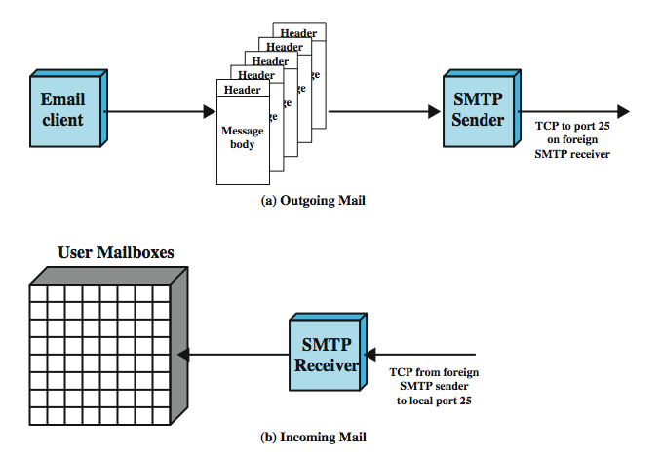
SMTP Mail Flow
Notes:
Stallings DCC8e Figure 22.1 illustrates the overall flow of mail in a typical system. Although much of this activity is outside the scope of SMTP, the figure illustrates the context within which SMTP typically operates.

Slide 7
Mail Message Contents
each queued message has two parts
message text
  RFC 822 header with envelope and list of recipients
  message body, composed by user
list of mail destinations
  derived by user agent from header
  may be listed in header
  may require expansion of mailing lists
  may need replacement of mnemonic names with mailbox names
if BCCs indicated, user agent needs to prepare correct message format
Notes:
Although the structure of the outgoing mail queue will differ depending on the host's operating system, each queued message conceptually has two parts:
1. The message text, consisting ofThe RFC 822 header (constitutes the message envelope and includes an indication of the intended recipient or recipients), andt he body of the message, composed by the user.
2. A list of mail destinations.
The list of mail destinations for the message is derived by the user agent from the 822 message header. In some cases, the destination or destinations are literally specified in the message header. In other cases, the user agent may need to expand mailing list names, remove duplicates, and replace mnemonic names with actual mailbox names. If any blind carbon copies (BCCs) are indicated, the user agent needs to prepare messages that conform to this requirement. The basic idea is that the multiple formats and styles preferred by humans in the user interface are replaced by a standardized list suitable for the SMTP send program.

Slide 8
SMTP Sender
takes message from queue
transmits to proper destination host
  via SMTP transaction
  over one or more TCP connections to port 25
host may have multiple senders active
host must create receivers on demand
when delivery complete, sender deletes destination from list for that message
when all destinations processed, message is deleted
Notes:
The SMTP sender takes messages from the outgoing mail queue and transmits them to the proper destination host via SMTP transactions over one or more TCP connections to port 25 on the target hosts. A host may have multiple SMTP senders active simultaneously if it has a large volume of outgoing mail, and should also have the capability of creating SMTP receivers on demand so that mail from one host cannot delay mail from another. Whenever the SMTP sender completes delivery of a particular message to one or more users on a specific host, it deletes the corresponding destinations from that message's destination list. When all destinations for a particular message are processed, the message is deleted from the queue.

Slide 9
Sending Optimizations
if message destined for multiple users on a given host, it is sent only once
  delivery to users handled at destination host
if multiple messages ready for given host, a single TCP connection can be used
  saves overhead of setting up and dropping connection
Notes:
In processing a queue, the SMTP sender can perform a variety of optimizations. If a particular message is sent to multiple users on a single host, the message text need be sent only once. If multiple messages are ready to send to the same host, the SMTP sender can open a TCP connection, transfer the multiple messages, and then close the connection, rather than opening and closing a connection for each message.

Slide 10
Possible Errors
host unreachable
host out of operation
TCP connection fail during transfer
sender can re-queue mail
  give up after a period
faulty destination address
  user error
  target user changed address
  redirect if possible
  inform user if not
Notes:
The SMTP sender must deal with a variety of errors. The destination host may be unreachable, out of operation, or the TCP connection may fail while mail is being transferred. The sender can requeue the mail for later delivery, but give up after some period rather than keep the message in the queue indefinitely. A common error is a faulty destination address, which can occur due to user input error or because the intended destination user has a new address on a different host. The SMTP sender must either redirect the message if possible or return an error notification to the message's originator.

Slide 11
SMTP Protocol - Reliability
used to transfer messages from sender to receiver over TCP connection
attempts to provide reliable service
no guarantee to recover lost messages
no end to end acknowledgement to originator
error indication delivery not guaranteed
generally considered reliable
Notes:
The SMTP protocol is used to transfer a message from the SMTP sender to the SMTP receiver over a TCP connection. SMTP attempts to provide reliable operation but does not guarantee to recover from lost messages. SMTP does not return an end-to-end acknowledgment to a message's originator to indicate that a message is successfully delivered to the message's recipient. Also, SMTP does not guarantee to return error indications. However, the SMTP-based mail system is generally considered reliable.

Slide 12
SMTP Receiver
accepts arriving message
places in user mailbox or copies to outgoing queue for forwarding
receiver must:
  verify local mail destinations
  deal with errors
sender responsible for message until receiver confirm complete transfer
  indicates mail has arrived at host, not user
Notes:
The SMTP receiver accepts each arriving message and either places it in the appropriate user mailbox or copies it to the local outgoing mail queue if forwarding is required. The SMTP receiver must be able to verify local mail destinations and deal with errors, including transmission errors and lack of storage capacity.
The SMTP sender is responsible for a message up to the point where the SMTP receiver indicates that the transfer is complete; however, this simply means that the message has arrived at the SMTP receiver, not that the message has been delivered to and retrieved by the intended final recipient. The SMTP receiver's error-handling responsibilities are generally limited to giving up on TCP connections that fail or are inactive for very long periods. Thus, the sender has most of the error recovery responsibility. Errors during completion indication may cause duplicate, but not lost, messages.

Slide 13
SMTP Forwarding
mostly direct transfer from sender host to receiver host
may go through intermediate machine via forwarding capability
  sender can specify route
  target user may have moved
Notes:
In most cases, messages go directly from the mail originator's machine to the destination machine over a single TCP connection. However, mail will occasionally go through intermediate machines via an SMTP forwarding capability, in which case the message must traverse a series of TCP connections between source and destination. One way for this to happen is for the sender to specify a route to the destination in the form of a sequence of servers. A more common event is forwarding required because a user has moved.

Slide 14
Conversation
SMTP limited to conversation between sender and receiver
main function is to transfer messages
rest of mail handling beyond scope of SMTP and may differ between systems
Notes:
It is important to note that the SMTP protocol is limited to the conversation that takes place between the SMTP sender and the SMTP receiver. SMTP's main function is the transfer of messages, although there are some ancillary functions dealing with mail destination verification and handling. The rest of the mail-handling apparatus depicted in Figure 22.1 is beyond the scope of SMTP and may differ from one system to another.

Slide 15
SMTP System Overview
commands and responses exchanged between sender and receiver
initiative with sender
  establishes TCP connection
sender sends a command to receiver
  e.g. HELO<SP><domain><CRLF>
generates exactly one reply
  e.g. 250 requested mail action ok; completed
Notes:
The operation of SMTP consists of a series of commands and responses exchanged between the SMTP sender and receiver. The initiative is with the SMTP sender, who establishes the TCP connection. Once the connection is established, the SMTP sender sends commands over the connection to the receiver. Each command generates exactly one reply from the SMTP receiver.

Slide 16
SMTP Commands
Notes:
Stallings DCC8e Table 22.1 lists the SMTP commands. Each command consists of a single line of text, beginning with a four-letter command code followed in some cases by an argument field. Most replies are a single-line, although multiple-line replies are possible. The table lists first those commands that all receivers must be able to recognize. The other commands are optional and may be ignored by the receiver.

Slide 17
SMTP Replies
positive completion reply (2xx)
  e.g. 220 <domain> Service ready
  e.g. 250 Requested mail action okay, completed
positive intermediate reply (3xx)
  e.g. 354 Start mail input; end with <CRLF>.<CRLF>
transient negative completion reply (4xx)
  e.g. 452 Requested action not taken: insufficient system storage
permanent negative completion reply (5xx)
  e.g. 500 Syntax error, command unrecognized
  e.g. 550 Requested action not taken: mailbox unavailable (e.g., mailbox not found, no access)
Notes:
SMTP replies are listed in Stallings DCC8e Table 22.2. Each reply begins with a three-digit code and may be followed by additional information. The leading digit indicates the category of the reply:
• Positive Completion reply: The requested action has been successfully completed. A new request may be initiated.
• Positive Intermediate reply: The command has been accepted, but the requested action is being held in abeyance, pending receipt of further information. The sender-SMTP should send another command specifying this information. This reply is used in command sequence groups.
• Transient Negative Completion reply: The command was not accepted and the requested action did not occur. However, the error condition is temporary and the action may be requested again.
• Permanent Negative Completion reply: The command was not accepted and the requested action did not occur.

Slide 18
Connection Setup
sender opens TCP connection with receiver
once connected, receiver identifies itself
  220 <domain> service ready
sender identifies itself
  HELO
receiver accepts sender’s identification
  250 OK
if mail service not available, step 2 returns:
  421 service not available
Notes:
Basic SMTP operation occurs in three phases: connection setup, exchange of one or more command-response pairs, and connection termination.
In the connection setup phase, an SMTP sender will attempt to set up a TCP connection with a target host when it has one or more mail messages to deliver to that host. The sequence is quite simple:
1. The sender opens a TCP connection with the receiver.
2. Once the connection is established, the receiver identifies itself with "220 Service Ready".
3. The sender identifies itself with the HELO command.
4. The receiver accepts the sender's identification with "250 OK".
If the mail service on the destination is unavailable, the destination host returns a "421 Service Not Available" reply in step 2 and the process is terminated.

Slide 19
Mail Transfer
sender may then send one or more messages
MAIL command identifies originator
  gives reverse path to used for error reporting
  receiver returns 250 OK or fail/error message
one or more RCPT commands identifies recipients for the message
DATA command transfers message text
  end of message shown by line containing just period .
Notes:
Once a connection has been established, the SMTP sender may send one or more messages to the SMTP receiver. There are three logical phases to the transfer of a message:
1. A MAIL command identifies the originator of the message. The MAIL command gives the reverse path, which can be used to report errors. If the receiver is prepared to accept messages from this originator, it returns a "250 OK" reply. Otherwise the receiver returns a reply indicating failure to execute the command (codes 451, 452, 552) or an error in the command (codes 421, 500, 501).
2. One or more RCPT commands identify the recipients for this message. The RCPT command identifies an individual recipient of the mail data; multiple recipients are specified by multiple use of this command. A separate reply is returned for each RCPT command. The receiver can accept the destination with a 250 reply; or return an appropriate fail/error response.
3. A DATA command transfers the message text. The advantage of using a separate RCPT phase is that the sender will not send the message until it is assured that the receiver is prepared to receive the message for at least one recipient, thereby avoiding the overhead of sending an entire message only to learn that the destination is unknown. Once the SMTP receiver has agreed to receive the mail message for at least one recipient, the SMTP sender uses the DATA command to initiate the transfer of the message. The end of the message is indicated by a line containing only a period.

Slide 20
Example SMTP Transfer
S: MAIL FROM:<Smith@Alpha.ARPA>
R: 250 OK
S: RCPT TO:<Jones@Beta.ARPA>
R: 250 OK
S: RCPT TO:<Green@Beta.ARPA>
R: 550 No such user here
S: RCPT TO:<Brown@Beta.ARPA>
R: 250 OK
S: DATA
R: 354 Start mail input; end with <CRLF>.<CRLF>
S: Blah blah blah...
S: ...etc. etc. etc.
S: <CRLF>.<CRLF>
R: 250 OK
Notes:
This example, taken from RFC 821, illustrates the SMTP mail transfer process. The SMTP sender is transmitting mail that originates with the user Smith@Alpha.ARPA. The message is addressed to three users on machine Beta.ARPA, namely, Jones, Green, and Brown. The SMTP receiver indicates that it has mailboxes for Jones and Brown but does not have information on Green. Because at least one of the intended recipients has been verified, the sender proceeds to send the text message.

Slide 21
Closing Connection
two steps
sender sends QUIT and waits for reply
then initiate TCP close operation
receiver initiates TCP close after sending reply to QUIT
Notes:
The SMTP sender closes the connection in two steps. First, the sender sends a QUIT command and waits for a reply. The second step is to initiate a TCP close operation for the TCP connection. The receiver initiates its TCP close after sending its reply to the QUIT command.

Slide 22
RFC 882 Email Format
message has envelope and contents
envelope contains information required to transmit and deliver message
content defined by RFC822
message is sequence of lines of text
  uses general memo framework
    multiple header lines, rigid format, then arbitrary text body
  each header line has form:
    keyword: arguments
Notes:
RFC 822 defines a format for text messages that are sent using electronic mail. The SMTP standard adopts RFC 822 as the format for use in constructing messages for transmission via SMTP. In the RFC 822 context, messages are viewed as having an envelope and contents. The envelope contains whatever information is needed to accomplish transmission and delivery. The contents comprise the object to be delivered to the recipient. The RFC 822 standard applies only to the contents. However, the content standard includes a set of header fields that may be used by the mail system to create the envelope, and the standard is intended to facilitate the acquisition of such information by programs.
An RFC 822 message consists of a sequence of lines of text and uses a general "memo" framework. That is, a message consists of some number of header lines, which follow a rigid format, followed by a body portion consisting of arbitrary text.

Slide 23
Example Message
Date:Tue, 16 Jan 1996 10:37:17 (EST)
From: “William Stallings” <ws@host.com>
Subject:The syntax of RFC 822
To: Smith@otherhost.com
Cc: Jones@Yet-another_host.com
This is the main text, delimited from the header by a blank line.
Notes:
A header line usually consists of a keyword, followed by a colon, followed by the keyword's arguments; the format allows a long line to be broken up into several lines. The most frequently used keywords are From, To, Subject, and Date. Shown here is an example message.

Slide 24
Multipurpose Internet Mail Extension (MIME)
extension to RFC822 to resolve issues like:
SMTP can not transmit executables
can not transmit text including international characters (e.g. â, å, ä, è, é, ê, ë)
servers may reject mail over certain size
ASCII to EBCDIC translation not standard
SMTP gateways to X.400 can not handle non-text data in X.400 messages
some SMTP implementations do not adhere to standard
Notes:
MIME is an extension to the RFC 822 framework that is intended to address some of the problems and limitations of the use of SMTP and RFC 822 for electronic mail, in a manner that is compatible with existing RFC 822 implementations. [RODR02] lists the following limitations of the SMTP/822 scheme:
1. SMTP cannot transmit executable files or other binary objects. A number of schemes are in use for converting binary files into a text form that can be used by SMTP mail systems, including the popular UNIX UUencode/UUdecode scheme. However, none of these is a standard or even a de facto standard.
2. SMTP cannot transmit text data that includes national language characters because these are represented by 8-bit codes with values of 128 decimal or higher, and SMTP is limited to 7-bit ASCII.
3. SMTP servers may reject mail messages over a certain size.
4. SMTP gateways that translate between the character codes ASCII and EBCDIC do not use a consistent set of mappings, resulting in translation problems.
5. SMTP gateways to X.400 electronic mail networks cannot handle nontextual data included in X.400 messages.
6. Some SMTP implementations do not adhere completely to the SMTP standards defined in RFC 821.

Slide 25
Overview of MIME
five new message header fields
  MIME version
  Content type
  Content transfer encoding
  Content Id
  Content Description
number of content formats defines
transfer encoding defined
Notes:
The MIME specification includes the following elements:
1. Five new message header fields are defined, which may be included in an RFC 822 header. These fields provide information about the body of the message. The five header fields defined in MIME are:
• MIME-Version: Must have the parameter value 1.0. This field indicates that the message conforms to the RFCs.
• Content-Type: Describes the data contained in the body with sufficient detail that the receiving user agent can pick an appropriate agent or mechanism to present the data to the user or otherwise deal with the data in an appropriate manner.
• Content-Transfer-Encoding: Indicates the type of transformation that has been used to represent the body of the message in a way that is acceptable for mail transport.
• Content-ID: Used to uniquely identify MIME entities in multiple contexts.
• Content-Description: A plaintext description of the object with the body; this is useful when the object is not displayable
2. A number of content formats are defined, thus standardizing representations that support multimedia electronic mail.
3. Transfer encodings are defined that enable the conversion of any content format into a form that is protected from alteration by the mail system.

Slide 26
Content Type/Subtype
Text body - in given character set
Multipart - body contains multiple parts
Message
Image
Video
Audio
Application
Notes:
The bulk of the MIME specification is concerned with the definition of a variety of content types. This reflects the need to provide standardized ways of dealing with a wide variety of information representations in a multimedia environment. Stallings DCC8e Table 22.3 lists the MIME content types. There are seven different major types of content and a total of 14 subtypes. In general, a content type declares the general type of data, and the subtype specifies a particular format for that type of data.
For the text type of body, no special software is required to get the full meaning of the text, aside from support of the indicated character set. The only defined subtype is plaintext, which is simply a string of ASCII characters or ISO 8859 characters. An earlier version of the MIME specification included a richtext subtype, which allows greater formatting flexibility. It is expected that this subtype will reappear in a later RFC.
The multipart type indicates that the body contains multiple, independent parts. The Content-Type header field includes a parameter, called boundary, that defines the delimiter between body parts. This boundary should not appear in any parts of the message. Each boundary starts on a new line and consists of two hyphens followed by the boundary value. The final boundary, which indicates the end of the last part, also has a suffix of two hyphens. Within each part, there may be an optional ordinary MIME header.
The message type provides a number of important capabilities in MIME.
The other types carry specific forms of audio/image/video/application data.

Slide 27
Multipart MIME Example
From: John Smith <js@company.com>
To: Ned Jones <ned@soft.com>
Subject: Sample message
MIME-Version: 1.0
Content-type: multipart/mixed; boundary="simple boundary"
This is the preamble. It is to be ignored, though it is a handy place for mail composers to include an explanatory note to non-MIME conformant readers.
--simple boundary
This is implicitly typed plain ASCII text. It does NOT end with a linebreak.
--simple boundary
Content-type: text/plain; charset=us-ascii
This is explicitly typed plain ASCII text. It DOES end with a linebreak.
--simple boundary--
This is the epilogue. It is also to be ignored.
Notes:
Shown here is a simple example of a multipart message, containing two parts both consisting of simple text.
There are four subtypes of the multipart type, all of which have the same overall syntax. The multipart/mixed subtype is used when there are multiple independent body parts that need to be bundled in a particular order (as in this example). For the multipart/parallel subtype, the order of the parts is not significant (e.g. text & graphics). For the multipart/alternative subtype, the various parts are different representations of the same information (e.g. plain text and HTML). The multipart/digest subtype is used when each of the body parts is interpreted as an RFC 822 message with headers.

Slide 28
MIME Transfer Encodings
reliable delivery over range of environments
uses content transfer encoding field
  3 specify bit interpretation, other 3 encodings
Quoted-printable
  data largely printable ASCII characters
  non-printing characters represented by hex code
Base64
  maps arbitrary binary input onto printable output
X-token
  named nonstandard encoding
Notes:
The other major component of the MIME specification, in addition to content type specification, is a definition of transfer encodings for message bodies. The objective is to provide reliable delivery across the largest range of environments. The MIME standard defines two methods of encoding data. The Content-Transfer-Encoding field can actually take on six values, as listed in Stallings DCC8e Table 22.4. However, three of these values (7bit, 8bit, and binary) indicate that no encoding has been done but provide some information about the nature of the data. For SMTP transfer, it is safe to use the 7bit form.
The quoted-printable transfer encoding is useful when the data consist largely of octets that correspond to printable ASCII characters. In essence, it represents non-safe characters by the hexadecimal representation of their code and introduces reversible (soft) line breaks to limit message lines to 76 characters.
The base64 transfer encoding, also known as radix-64 encoding, is a common one for encoding arbitrary binary data in such a way as to be invulnerable to the processing by mail transport programs. This technique maps arbitrary binary input into printable character output using 65 printable characters that all sites should be able to handle.
The x-token indicates that some other encoding scheme is used, for which a name is to be supplied. This could be a vendor-specific or application-specific scheme.

Slide 29
Network Management
networks are becoming indispensable
more complexity makes failure more likely
require automatic network management tools
standards required to allow multi-vendor networks
covering:
  services
  protocols
  Management information base (MIB)
Notes:
Networks and distributed processing systems are of critical and growing importance in business, government, and other organizations. Within a given organization, the trend is toward larger, more complex networks supporting more applications and more users. A large, reliable network cannot be put together and managed by human effort alone. The complexity of such a system dictates the use of automated network management tools. The urgency of the need for such tools is increased, and the difficulty of supplying such tools is also increased, if the network includes equipment from multiple vendors. In response, standards that deal with network management have been developed, covering services, protocols, and management information base.

Slide 30
Network Management Systems
collection of tools for network management
single operator interface
powerful, user friendly command set
performing most or all management tasks
minimal amount of separate equipment
  i.e. use existing equipment
view entire network as unified architecture
active elements provide regular feedback
Notes:
A network management system is a collection of tools for network monitoring and control that is integrated in the following senses. It has a single operator interface with a powerful but user-friendly set of commands for performing most or all network management tasks. It needs a minimal amount of additional equipment. That is, most of the hardware and software required for network management is incorporated into the existing user equipment.
A network management system consists of incremental hardware and software additions implemented among existing network components. The software used in accomplishing the network management tasks resides in the host computers and communications processors (e.g., networks switches, routers). A network management system is designed to view the entire network as a unified architecture, with addresses and labels assigned to each point and the specific attributes of each element and link known to the system. The active elements of the network provide regular feedback of status information to the network control center.

Slide 31
Simple Network Management Protocol (SNMP)
SNMP v1 developed for managing TCP/IP (inter) networks
defines protocol, database, other concepts
basic concepts
  management station or manager
  agent
  management information base
  network management protocol
Notes:
SNMP was developed for use as a network management tool for networks and internetworks operating TCP/IP. It has since been expanded for use in all types of networking environments. The term simple network management protocol (SNMP) is actually used to refer to a collection of specifications for network management that include the protocol itself, the definition of a database, and associated concepts.
The model of network management that is used for SNMP includes the following key elements:
• Management station, or manager
• Agent
• Management information base
• Network management protocol

Slide 32
Management Station
stand alone system or part of shared system
interface for human network manager
set of management applications
  data analysis
  fault recovery
interface to monitor and control network
translate manager’s requirements into monitoring and control of remote elements
data base of network management information extracted from managed entities
Notes:
The management station is typically a standalone device, but may be a capability implemented on a shared system. In either case, the management station serves as the interface for the human network manager into the network management system. The management station will have, at minimum:
• A set of management applications for data analysis, fault recovery, and so on
• An interface by which the network manager may monitor and control the network
• The capability of translating the network manager's requirements into the actual monitoring and control of remote elements in the network
• A database of network management information extracted from the databases of all the managed entities in the network
Only the last two elements are the subject of SNMP standardization.

Slide 33
Management Agent
equip key platforms with agent software
  e.g. hosts, bridges, hubs, routers
allows their management by management station
respond to requests for information
respond to requests for action
asynchronously supply unsolicited information
Notes:
The other active element in the network management system is the management agent. Key platforms, such as hosts, bridges, routers, and hubs, may be equipped with agent software so that they may be managed from a management station. The agent responds to requests for information from a management station, responds to requests for actions from the management station, and may asynchronously provide the management station with important but unsolicited information.

Slide 34
Management Information Base (MIB)
representation of network resources as objects
each object a variable representing one aspect of managed object
MIB is collection of access points at agent for management of station
objects standardized across class of system
  bridge, router etc.
management station
  retrieves values of MIB objects to provide monitoring
  sets MIB object values to change configuration
Notes:
To manage resources in the network, each resource is represented as an object. An object is, essentially, a data variable that represents one aspect of the managed agent. The collection of objects is referred to as a management information base (MIB). The MIB functions as a collection of access points at the agent for the management station. These objects are standardized across systems of a particular class (e.g., bridges all support the same management objects). A management station performs the monitoring function by retrieving the value of MIB objects. A management station can cause an action to take place at an agent or can change the configuration settings of an agent by modifying the value of specific variables.

Slide 35
Network Management Protocol
link between management station & agent
  TCP/IP uses SNMP
  OSI uses Common Management Information Protocol (CMIP)
  SNMPv2 (enhanced SNMP) for OSI & TCP/IP
key capabilities
  get - management station retrieves value
  set - management station sets value
  notify - agent sends event notification
Notes:
The management station and agents are linked by a network management protocol. The protocol used for the management of TCP/IP networks is the Simple Network Management Protocol (SNMP). An enhanced version of SNMP, known as SNMPv2, is intended for both TCP/IP- and OSI-based networks. Each of these protocols includes the following key capabilities:
• Get: Enables the management station to retrieve the value of objects at the agent
• Set: Enables the management station to set the value of objects at the agent
• Notify: Enables an agent to send unsolicited notifications to the management station of significant events

Slide 36
Management Layout
may be centralized in simple network
may be distributed in large, complex network
  multiple management servers
  each manages pool of agents
  management may be delegated to intermediate manager
Notes:
In a traditional centralized network management scheme, one host in the configuration has the role of a network management station; there may be one or two other management stations in a backup role. The remainder of the devices on the network contain agent software and a MIB, to allow monitoring and control from the management station. As networks grow in size and traffic load, such a centralized system is unworkable. Too much burden is placed on the management station, and there is too much traffic, with reports from every single agent having to wend their way across the entire network to headquarters. In such circumstances, a decentralized, distributed approach works best. In a decentralized network management scheme, there may be multiple top-level management stations, which might be referred to as management servers. Each such server might directly manage a portion of the total pool of agents. However, for many of the agents, the management server delegates responsibility to an intermediate manager. The intermediate manager plays the role of manager to monitor and control the agents under its responsibility. It also plays an agent role to provide information and accept control from a higher-level management server. This type of architecture spreads the processing burden and reduces total network traffic.

Slide 37
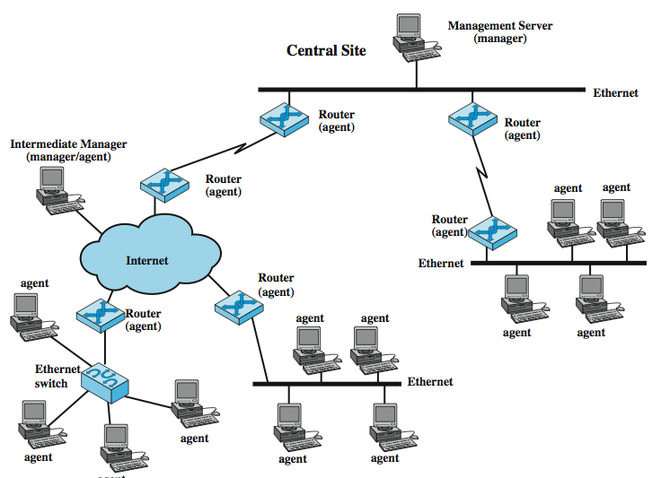
Distributed Network Management Example
Notes:
Stallings DCC8e Figure 22.3 illustrates a decentralized, distributed network management approach.

Slide 38
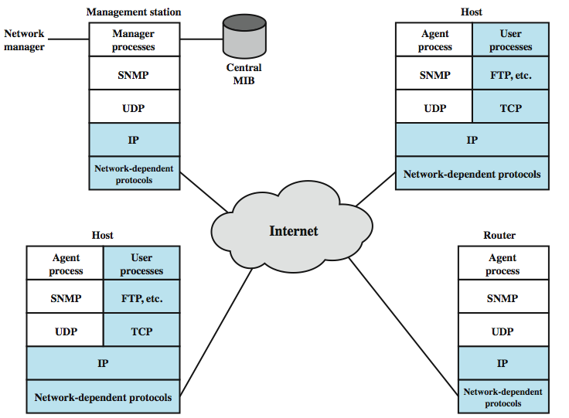
SNMP Architecture
Notes:
SNMP is an application-level protocol that is part of the TCP/IP protocol suite. It is intended to operate over the user datagram protocol (UDP). Stallings DCC8e Figure 22.4 suggests the typical configuration of protocols for SNMPv1. For a standalone management station, a manager process controls access to a central MIB at the management station and provides an interface to the network manager. The manager process achieves network management by using SNMP, which is implemented on top of UDP, IP, and the relevant network-dependent protocols (e.g., Ethernet, ATM, frame relay). Each agent must also implement SNMP, UDP, and IP. In addition, there is an agent process that interprets the SNMP messages and controls the agent's MIB. For an agent device that supports other applications, such as FTP, TCP as well as UDP is required. In this figure, the shaded portions depict the operational environment: that which is to be managed. The unshaded portions provide support to the network management function.

Slide 39
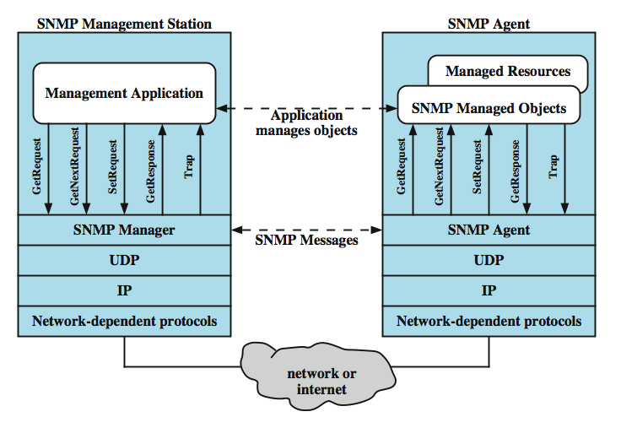
SNMP Architecture
Notes:
Stallings DCC8e Figure 22.5 provides a somewhat closer look at the protocol context of SNMP. From a management station, three types of SNMP messages are issued on behalf of a management applications: GetRequest, GetNextRequest, and SetRequest. The first two are two variations of the get function. All three messages are acknowledged by the agent in the form of a GetResponse message, which is passed up to the management application. In addition, an agent may issue a trap message in response to an event that affects the MIB and the underlying managed resources. Management requests are sent to UDP port 161, while the agent sends traps to UDP port 162.
Because SNMP relies on UDP, which is a connectionless protocol, SNMP is itself connectionless. No ongoing connections are maintained between a management station and its agents. Instead, each exchange is a separate transaction between a management station and an agent.

Slide 40
SNMP v1
August 1988 SNMP specification issued
stand alone management stations and bridges, routers workstations etc supplied with agents
defines limited, easily implemented MIB of scalar variables and two dimensional tables
streamlined protocol
limited functionality
lack of security
SNMP v2 1993, revised 1996
  RFC 1901-1908
Notes:
In August of 1988, the specification for SNMP was issued and rapidly became the dominant network management standard. A number of vendors offer standalone network management workstations based on SNMP, and most vendors of bridges, routers, workstations, and PCs offer SNMP agent packages that allow their products to be managed by an SNMP management station. As the name suggests, SNMP is a simple tool for network management. It defines a limited, easily implemented management information base (MIB) of scalar variables and two-dimensional tables, and it defines a streamlined protocol to enable a manager to get and set MIB variables and to enable an agent to issue unsolicited notifications, called traps. This simplicity is the strength of SNMP. SNMP is easily implemented and consumes modest processor and network resources. Also, the structure of the protocol and the MIB are sufficiently straightforward that it is not difficult to achieve interoperability among management stations and agent software from a mix of vendors.
With its widespread use, the deficiencies of SNMP became increasingly apparent; these include both functional deficiencies and a lack of a security facility. As a result, an enhanced version, known as SNMPv2, was issued (RFCs 1901, 1905 through 1909, and 2578 through 2580). SNMPv2 has quickly gained support, and a number of vendors announced products within months of the issuance of the standard.

Slide 41
Network Management Framework
have framework on which network management applications can be built
  e.g fault management, performance monitoring, accounting
management protocol is used to exchange management information
  e.g. SNMP v1 & v2
each player maintains local MIB
at least one system responsible for management
  houses management applications
Notes:
As with SNMPv1, SNMPv2 provides a framework on which network management applications can be built. Those applications, such as fault management, performance monitoring, accounting, and so on, are outside the scope of the standard. The essence of SNMPv2 is a protocol that is used to exchange management information. Each "player" in the network management system maintains a local database of information relevant to network management, known as the management information base (MIB). The SNMPv2 standard defines the structure of this information and the allowable data types; this definition is known as the structure of management information (SMI). We can think of this as the language for defining management information. The standard also supplies a number of MIBs that are generally useful for network management. In addition, new MIBs may be defined by vendors and user groups.
At least one system in the configuration must be responsible for network management. It is here that any network management applications are hosted. There may be more than one of these management stations, to provide redundancy or simply to split up the duties in a large network. Most other systems act in the role of agent. An agent collects information locally and stores it for later access by a manager. The information includes data about the system itself and may also include traffic information for the network or networks to which the agent attaches.

Slide 42
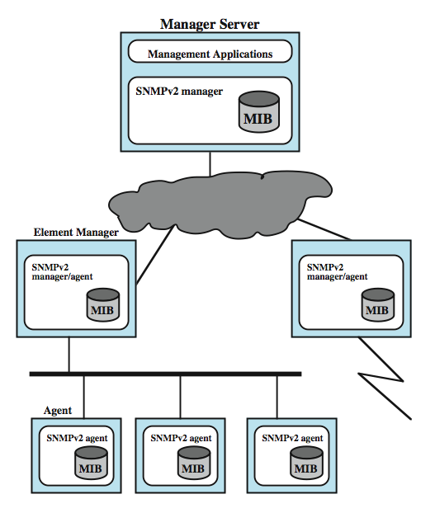
Exmple
SNMP v2
Managed
Config
Notes:
Stallings DCC8e Figure 22.6 is an example of a configuration that illustrates an example SNMPv2 network management infrastructure.

Slide 43
SNMP v2
support central or distributed management
in distributed system, some elements operate as manager and agent
exchanges use SNMP v2 protocol
  simple request/response protocol
  typically uses UDP
    ongoing reliable connection not required
    reduces management overhead
Notes:
SNMPv2 supports either a highly centralized network management strategy or a distributed one. In the latter case, some systems operate both in the role of manager and of agent. In its agent role, such a system will accept commands from a superior management system. Some of those commands relate to the local MIB at the agent. Other commands require the agent to act as a proxy for remote devices. In this case, the proxy agent assumes the role of manager to access information at a remote agent, and then assumes the role of an agent to pass that information on to a superior manager. All of these exchanges take place using the SNMPv2 protocol, which is a simple request/response type of protocol. Typically, SNMPv2 is implemented on top of the user datagram protocol (UDP), which is part of the TCP/IP suite. Because SNMPv2 exchanges are in the nature of discrete request-response pairs, an ongoing reliable connection is not required.

Slide 44
Structure of
Management Information (SMI)
defines general framework with which MIB defined and constructed
  identifies data types
  how resources are represented and named
encourages simplicity and extensibility
  has scalars and two dimensional arrays of scalars (tables) only
three key elements:
  data types, objects, object identifiers
Notes:
The structure of management information (SMI) defines the general framework within which a MIB can be defined and constructed. The SMI identifies the data types that can be used in the MIB, and how resources within the MIB are represented and named. The philosophy behind SMI is to encourage simplicity and extensibility within the MIB. Thus, the MIB can store only simple data types: scalars and two-dimensional arrays of scalars, called tables. The SMI does not support the creation or retrieval of complex data structures. This philosophy is in contrast to that used with OSI systems management, which provides for complex data structures and retrieval modes to support greater functionality. SMI avoids complex data types and structures to simplify the task of implementation and to enhance interoperability. Stallings DCC8e Table 22.6 shows the data types that are allowed by the SMI, including signed & unsigned integers, time ticks, octet strings, IP addresses, bit string and object identifiers.
There are three key elements in the SMI specification. At the lowest level, the SMI specifies the data types that may be stored. Then the SMI specifies a formal technique for defining objects and tables of objects. Finally, the SMI provides a scheme for associating a unique identifier with each actual object in a system, so that data at an agent can be referenced by a manager.

Slide 45
SNMP v2 PDU Formats
Notes:
The heart of the SNMPv2 framework is the protocol which provides a basic mechanism for the exchange of management information between manager and agent. The basic unit of exchange is the message, which consists of an outer message wrapper and an inner protocol data unit (PDU). Seven types of PDUs may be carried in an SNMP message. The general formats for these are illustrated informally in Stallings DCC8e Figure 22.7. Several fields are common to a number of PDUs. The request-id field is an integer assigned such that each outstanding request can be uniquely identified. The variable-bindings field contains a list of object identifiers; depending on the PDU, the list may also include a value for each object.
The GetRequest-PDU, issued by a manager, includes a list of one or more object names for which values are requested. The GetNextRequest-PDU also is issued by a manager and includes a list of one or more objects, where the value to be returned is for the object that is next in lexicographic order. The GetBulkRequest PDU allows an SNMPv2 manager to request that the response be as large as possible given the constraints on message size. The SetRequest-PDU is issued by a manager to request that the values of one or more objects be altered. The SNMPv2-Trap-PDU is generated and transmitted by an SNMPv2 entity acting in an agent role when an unusual event occurs. It is used to provide the management station with an asynchronous notification of some significant event. The InformRequest-PDU is sent by an SNMPv2 entity acting in a manager role, on behalf of an application, to another SNMPv2 entity acting in a manager role, to provide management information to an application using the latter entity.

Slide 46
SNMP v3
addresses security issues of SNMP v1/2
RFC 2570-2575
proposed standard January 1998
defines overall architecture and security capability
to be used with SNMP v2
defines three security services
  authentication
  privacy
  access control
Notes:
Many of the functional deficiencies of SNMP were addressed in SNMPv2. To correct the security deficiencies of SNMPv1/v2, SNMPv3 was issued as a set of Proposed Standards in January 1998 (currently RFCs 2570 through 2575). This set of documents does not provide a complete SNMP capability but rather defines an overall SNMP architecture and a set of security capabilities. These are intended to be used with the existing SNMPv2. SNMPv3 provides three important services: authentication, privacy, and access control. The first two are part of the User-Based Security (USM) model, and the last is defined in the View-Based Access Control Model (VACM). Security services are governed by the identity of the user requesting the service; this identity is expressed as a principal, which may be an individual or an application or a group of individuals or applications.

Slide 47
SNMP v3 Services
authentication assures that message is:
  from identified source, not altered, not delayed or replayed
  includes HMAC message authentication code
privacy
  encrypts messages using DES
access control
  pre configure agents to provide a number of levels of access to MIB for different managers
  restricting access to information
  limit operations
Notes:
The authentication mechanism in USM assures that a received message was transmitted by the principal whose identifier appears as the source in the message header. This mechanism also assures that the message has not been altered in transit and has not been artificially delayed or replayed. The sending principal provides authentication by including a message authentication code with the SNMP message it is sending. This code is a function of the contents of the message, the identity of the sending and receiving parties, the time of transmission, and a secret key that should be known only to sender and receiver. The secret key must be set up outside of USM as a configuration functionThe actual authentication code used is known as HMAC.
The privacy facility of USM enables managers and agents to encrypt messages. Again, manager principal and agent principal must share a secret key. In this case, if the two are configured to use the privacy facility, all traffic between them is encrypted using the Data Encryption Standard (DES). The sending principal encrypts the message using the DES algorithm and its secret key, and sends the message to the receiving principal, which decrypts it using the DES algorithm and the same secret key.
The access control facility makes it possible to configure agents to provide different levels of access to the agent's management information base (MIB) to different managers. An agent principal can restrict access to its MIB for a particular manager principal in two ways. First, it can restrict access to a certain portion of its MIB. Second, the agent can limit the operations that a manager can use on that portion of the MIB. The access control policy to be used by an agent for each manager must be preconfigured.

Slide 48
Summary
electronic mail
  SMTP (RFC821) mail exchange
  RFC822 & MIME mail content formats
network management
  elements and operation of SNMP v1, 2 & 3
Notes:
Chapter22 summary.

